Slide 1
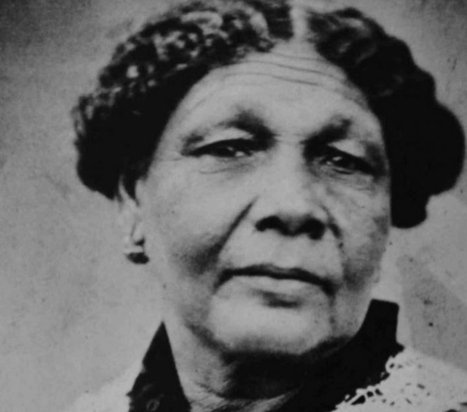
MARY SEACOLE
KS3 Learning Activities

Slide 2
Definitions
Head over to this link HERE to learn and test yourself on words in the video!

Slide 3
TEST yourself
What year was Mary Seacole born?
What was the title of Mary’s autobiography?
What is the name of the hospital with a statue of Mary and where is it located?
What is the significance of Mary Seacole’s contribution to war efforts and nursing?

Slide 4
GET CREATIVE AND WRITE A POEM USING THE INFORMATION FROM THESE ARTICLES ABOUT MARY SEACOLE
http://www.bbc.co.uk/history/historic_figures/seacole_mary.shtml
https://en.wikipedia.org/wiki/Mary_Seacole
https://www.maryseacoletrust.org.uk/learn-about-mary/

Slide 5
WRITE AN OPEN LETTER
In 2012, there was outrage at the proposal that Mary Seacole should be taken out of the national curriculum.
Write an open letter to the public explaining why it is so important for Mary Seacole to be taught in schools.
Max 250 words.
Please submit all entries to theblackcurriculum@gmail.com by the 17/4/20 for the chance to be featured on our Instagram!

